Slide 1
CSE 205 Honors Contract- JI84
Dylan Fulop

Slide 2
Introduction
Assignment: Choose a project that interests you. This could be a game or an application that has an academic purpose. The project has to be an advance GUI application using Java Programming language.
It took a while to come up with an idea that I found interesting, so while thinking about ideas I was doing math homework and thought about making a program that replicated the functions of a graphing calculator (specifically a TI84).
This program would have many of the functions of a TI84 but be a program using javafx and maybe even some more functionality, and most important difference was that you should be able to type in input

Slide 3
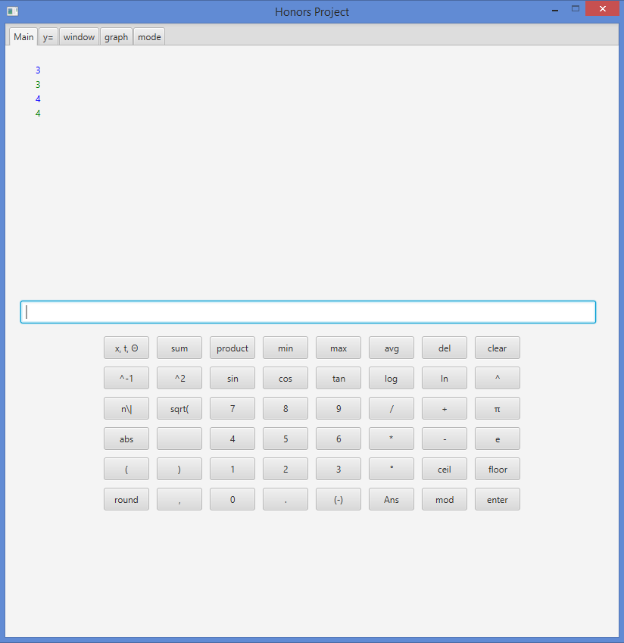
Starting out
I started with the overall GUI design of the program
When inputting expressions and giving results, there should be some sort of input grid representing the TI’s keyboard, but other than that, this Grid is not necessary in certain screens
I also decided that the buttons that took you to different screens would be replaced by tabs, more closely representing what they do
I also decided that to distinguish input from output on the main screen, I would use colors rather than alignment, as it was simpler to create and see

Slide 4
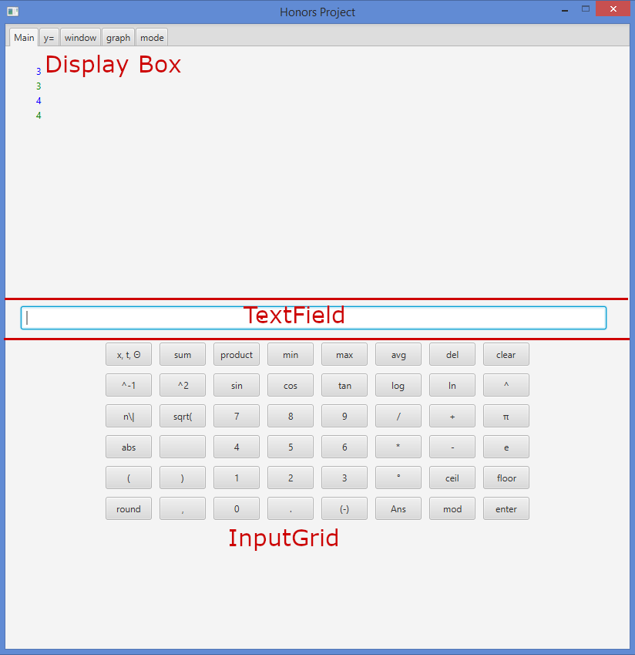
MainPane
The GUI for the main tab is programmed as a VBox with 3 elements
The first element is another VBox, an instance of a custom class called DisplayBox, Which consists of an arraylist of Labels that when an object is added (and there are already to many entries) will remove its first element, allowing the display to scroll upwards. Whenever an element is added, it refreshes and it’s children are the arraylist’s children in order
The second element is a simple TextField that is used for input.
The third element is an instance of a custom class InputGrid which has a 2d array of buttons, a final 2d array of button names (Strings), and a final 2d array of button outputs (Strings). It adds these buttons to the pane according to their locations in the 2d array and names them accordingly. When these buttons are pressed, if the button is not one of several special cases, the button output string will be pasted to the TextField

Slide 5
ExpressionParser Pt 1
The next thing to work on was reading input in the textfield as an expression to then read and turn into result. I made a class to handle doing all of this.
The main method in this class was readExp(double x, String var, String exp), and would evaluate exp replacing any instance of var with x
The majority of this method works using recursion. The string is split up by different symbols, and the method is called again on each string and the results are added, divided, multiplied, etc. This is how it works for multiplication, addition, subtraction, division, exponentiation, and roots.
The major problem that occured while working on this method, was that the String class’s split method does not work on “*” or “+”. This was solved through hours of confusion and eventually finding out that you must all split(“\\+”)
The other problem during this process was seperating negatives from subtraction. This was hard to solve and I simply created a temporary solution of requiring spaces for subtraction (no 3-2 only 3 - 2).
The next thing to create was a way of solving parentheses first, which I accomplished by creating a solve Parentheses method that would find opening and closing index of parentheses by working backwards from the index of the first closing parentheses, and calling readExp on everything in between that and the last ‘(‘ then repeating as long as there are opening parentheses. It would return a string that would replace exp.
Another method needed was the reduce method, which called the solve parentheses method, but also replaced e and pi with there appropriate values, and made sure the notation was consistent (specifically for roots: n\|x so sqrt(x) -> 2\|(x)).

Slide 6
ExpressionParser Pt2
The final group of features to add to the ExpressionParser were the functions that were called with parameters f(x) or f(x, y) or some with f(x₁, x₂, ... , x_{n}). (Includes sin(x), logb(b, x) = log_{b}(x) or mod(m, n) = m%n, and sum(x₁, x₂, ... , x_{n}).
The first case was accomplished with a method called findCloseIndex, which when passed the index of a certain function, would count the opening and closing parentheses until the counts were equal and return the index of the closing parenthesis. Then the substring from the opening index to the closing index would be replaced by the evaluated function.
For the 2nd/3rd case, it was also necessary to change the string, as commas from inner functions could be confused as separate parameters. The solution was to first have the method replace “,”’s while the ( count was 1> than the ) count with “_,_”, which distinguished them. Then it would return an object[][] with the closeIndex and the new string in certain indices. Then
For the 2nd case, the string would be split by “_,_” then if it was of size 2 it would evaluate using the first and second parameter accordingly or
For the 3rd case, it would loop through each parameter and evaluate based on each

Slide 7
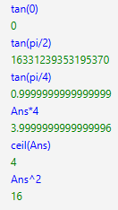

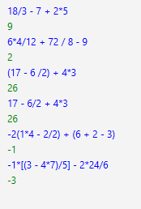

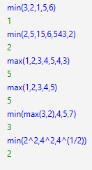
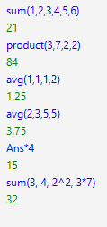

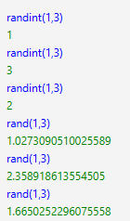
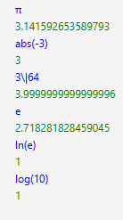


Main pane test cases

Slide 8
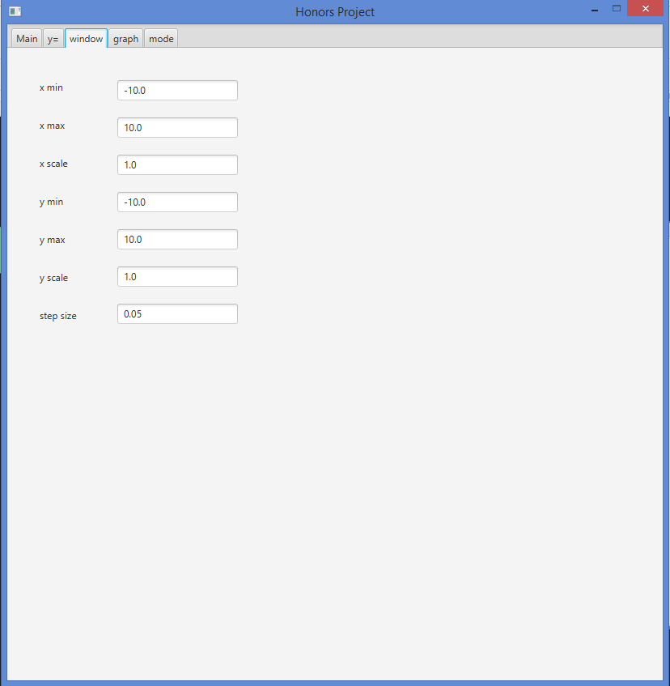
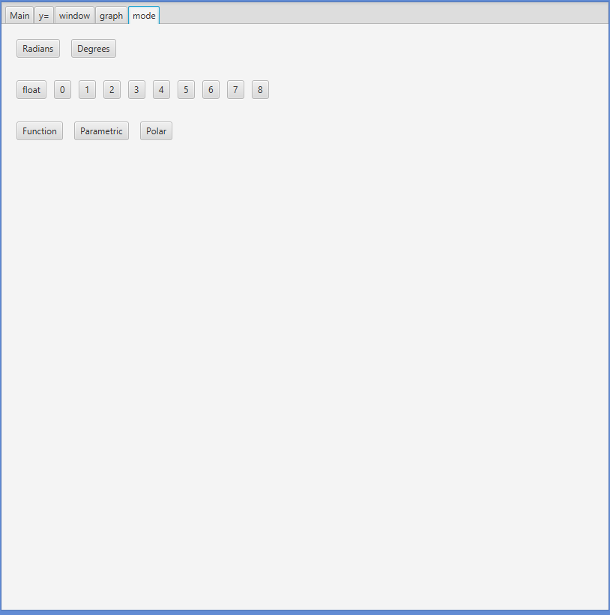
ModePane and WindowPane
The tabs for mode and window were relatively simple.
ModePane was a gridpane with several buttons which changed settings in an instance of the MathMode class.
WindowPane was labels next to textfields which changed values in an instance of the Window class

Slide 9
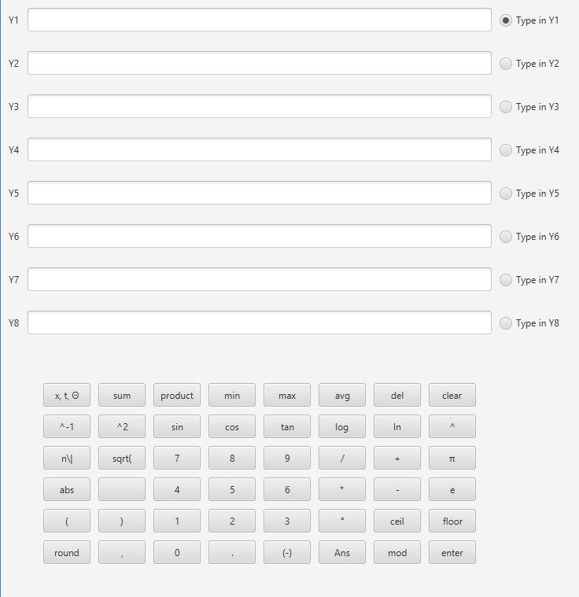
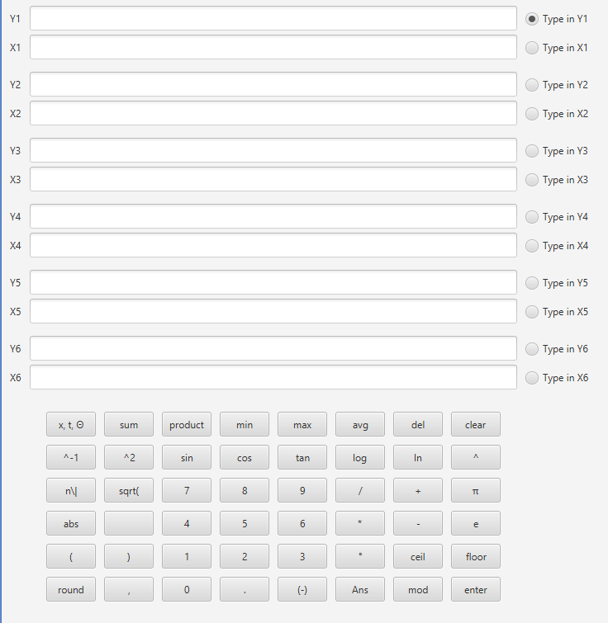
EqPane
The equation pane was fairly complicated GUI wise
There were several TextFields corresponding to specific labels and an input grid at the bottom, which would choose which text field to input into based on radio buttons
When the mode was changed to polar, the change was simple, but when changed to parametric, it required reformatting the entire GUI to include 2 labels for each equation

Slide 10




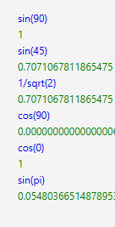
Adding Mode and Equation functionality to ExpressionParser
Before getting to the final part of this project, the recently added equation tab and mode tab should effect the main tbs results
MathMode class has a variable for radian mode that is a boolean, when calculating trig functions, ExpressionParser checks if this is true and if not will convert to radians from degrees
MathMode class has a variable for rounding, which is handled using decimal format in the MainPane class after the expression is parsed
Equations from y= tab are stored in a static arraylist in the Main class which is accessed by the ExpressionParser and read at the corresponding value of x in Y1(x) or Yi(x) using the same method used for other functions

Slide 11
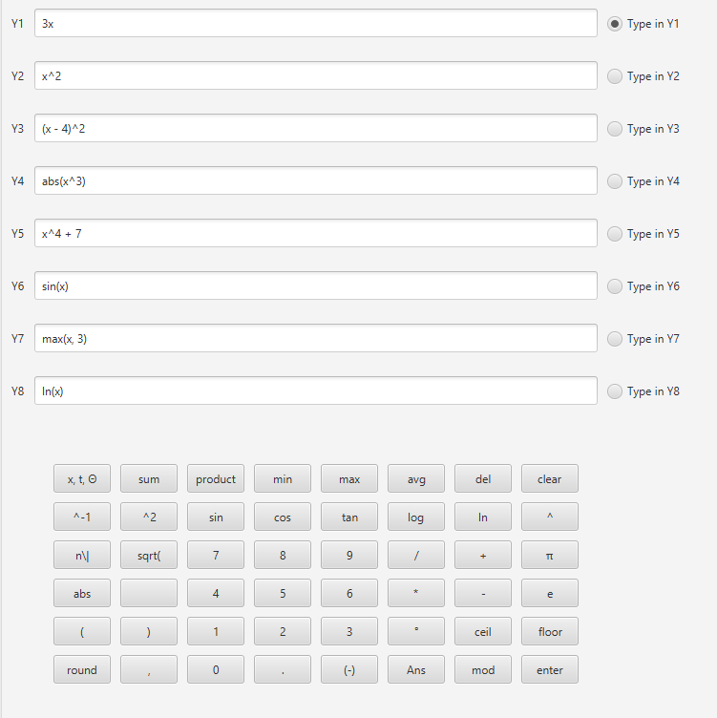


y= tab test cases

Slide 12
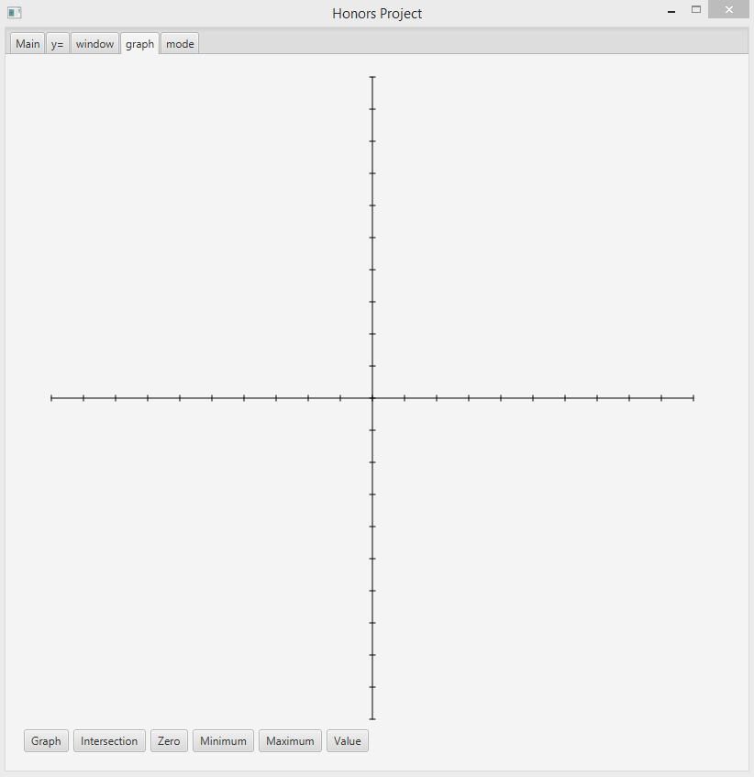
Graphing Tab Starting Layout
3 Parts to the GraphPane (BorderPane):
Top bar for output (GridPane)
Bottom bar for input (HBox)
Center portion would be blank for drawing the graph
Graph would be drawn by using a method called transform that takes in 2 x and y coordinates (the result of the function) and returns a line (transformed to fit properly in the frame based on the window settings).
When the pane is first created, the axes would be drawn using this method as going from the windows min to max and then scale lines would be drawn as well to be 3 pixels wide.

Slide 13
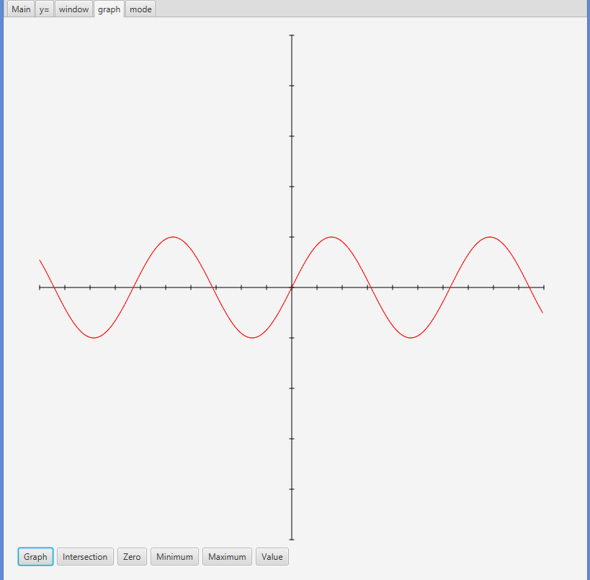
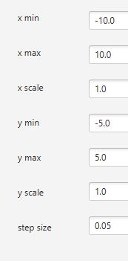

Graph Tab Graphing
Variable x is set to the minimum x value
Y is evaluated at the given x
Variable x2 is set to the x + stepsize (step size is configurable in the window tab but 0.05 by default)
Y2 is evaluated at x2
Add transform(x, y, x2, y2) to the graph pane if both ys < ymax & > ymin
Repeat while x < xmax
For other modes, it loops the same way the parameter, and evaluates both y and x

Slide 14
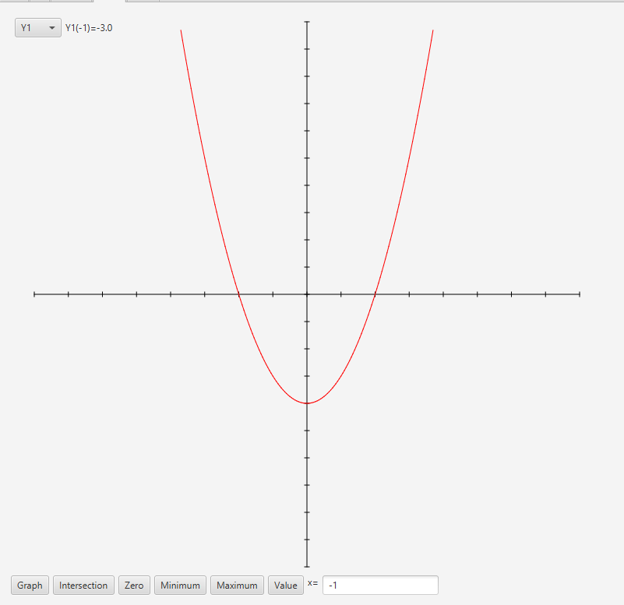
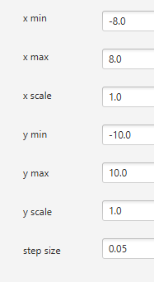

Graph Tab Value Function
When the value button is pressed, a textfield and combobox appear
The combobox can select one of the functions and is in the topbar
The textfield is where you enter the value of x t or theta to evaluate at
It will evaluate the function at that point and display it in the top bar when enter is pressed or the value button is pressed again

Slide 15
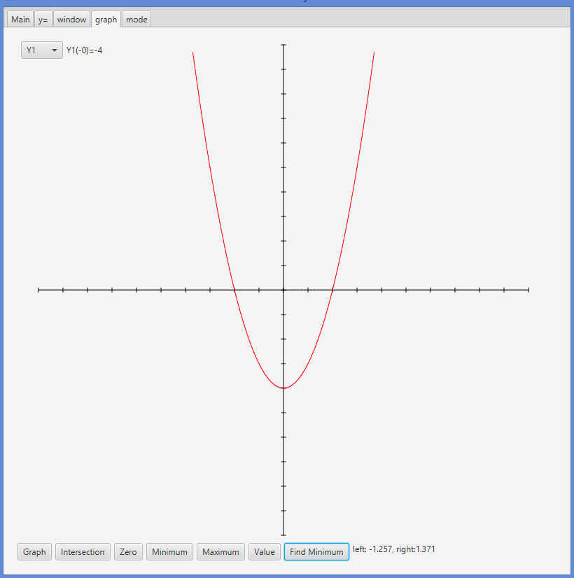
Graph Tab Finding Minimum
When button is pressed, a button labeled “Find Minimum” appears, along with the combobox and the textfield would dissappear. Then, you are able to click on two locations as a right and left bound, and then click find minimum to do the following:
Function called min which would take bounds and an string expression to minimize (exp), a double stepsize, a double minX, and an int i and maxI
Would loop x from lower bound to upper changing x by stepsize each time
Would evaluate exp at each point and if it is the new minimum reset the value
Would then call minimum at the point of the most recent minimum and with i+1 and a smaller stepsize
As long as i isn’t greater than maxI it would repeat this but
If i is not 0, it would consider changing the bounds to minX +- 25*stepsize in order to lower the amount of search locations, but only if this is within the original bounds
If i > maxI, it would change display labels in the top bar to reflect the result it found

Slide 16
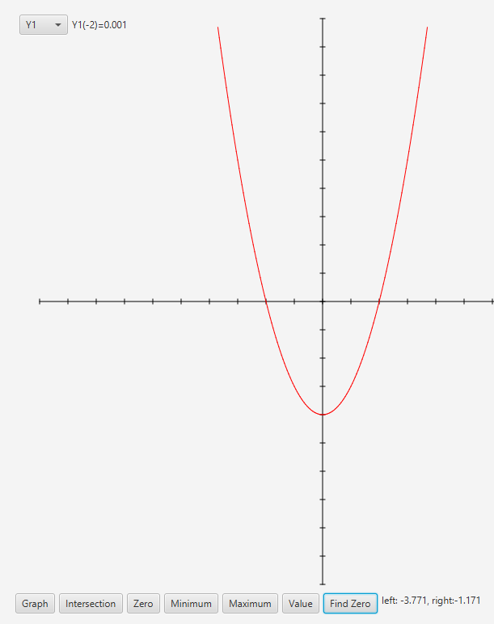
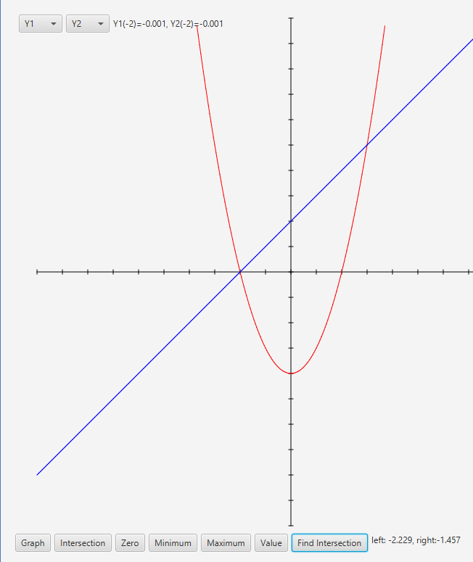
Graph Tab other functionality
Other functions of the graph tab would take advantage of the min method
Max would find the minimum of -Y
Zero would find the minimum of abs(y)
Intersect would find the minimum of abs(y1 - y2)
Had to add a boolean for isIntersect to add a second label after the min method finishes, also when you press intersect it creates 2 comboboxes

Slide 17
The End!
That is my project

